Slide 1
SKIDMORE X-POT PRESENTATION
2017

Slide 2
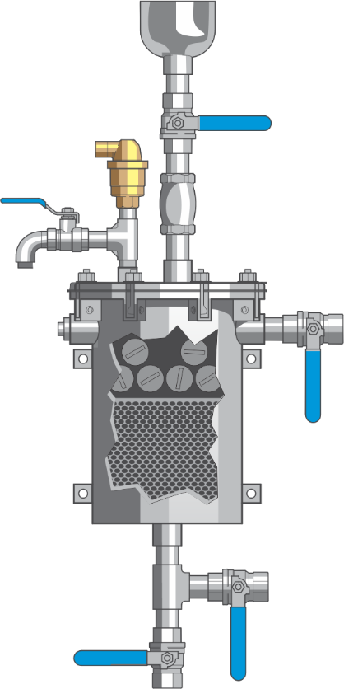
Patent Pending X-POT Slip Stream Filtration & Shot Feeder Units
Product Presentation by Darren Wilkinson & John Williams

Slide 3
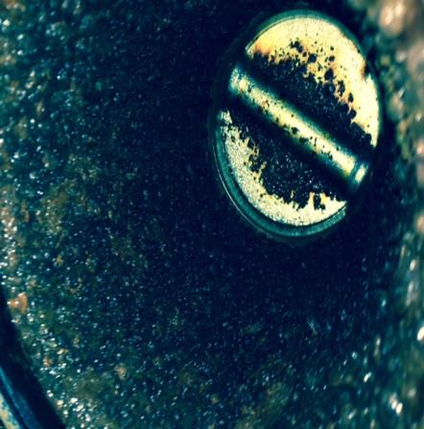
So why would a system benefit from an X-POT?
Above: A Condenser system heavily fouled with Biofilm, creating under deposit corrosion. Bacterial Bi Products also include gassing (usually mistaken for an Air problem)

Slide 4
2015 ASHRAE HANDBOOK-HVAC APPLICATIONS
Chapter 49-Water Treatment: Deposition, Corrosion, and Biological Control
49.1
“Proper treatment improves the performance and energy efficiency of these systems while helping to protect human health and safety. Water Treatment also extends the life of the equipment in both open-and closed loop systems. In addition, water treatment can help conserve water resources”.
49.2 Suspended Solids (Para 4)
“At high velocities, hard suspended particles can abrade equipment. Settled suspended matter of all types can contribute to corrosion”.
49.4 Scale
“A Layer of scale as thin a 1/64 in. can reduce heat exchanger efficiency by 15%.

Slide 5
2015 ASHRAE HANDBOOK-HVAC APPLICATIONS (Contd.)
Chapter 49-Water Treatment: Deposition, Corrosion, and Biological Control
49.5 Cartridge/Bag Filters
“These are typically used as final or tertiary filters to remove nearly all suspended particles”
49.7 Corrosion fatigue
“Cracks often initiate because of the action of applied cyclic stresses where metal surfaces are covered in magnetite film”
49.7 Crevice corrosion
“Occurs in the void between a metal and anther surface. In this void, and usually in the presence of a stagnant solution, a localised corrosion environment is created. Also referred to as under-deposit corrosion.

Slide 6
2015 ASHRAE HANDBOOK-HVAC APPLICATIONS (Contd.)
Chapter 49-Water Treatment: Deposition, Corrosion, and Biological Control
49.7 Erosion Corrosion
“Suspended solids in a solution can greatly contribute to erosion corrosion”
49.8 Factors affecting corrosion-Oxygen
“The more Oxygen, the greater the rate of corrosion!
49.9 Flow velocity
“When flow velocity is low (less than 3 fps), suspended solids can drop out and cause deposition as well as under-deposit corrosion, including concentration cell corrosion and microbial corrosion”.

Slide 7
2015 ASHRAE HANDBOOK-HVAC APPLICATIONS (Contd.)
Chapter 49-Water Treatment: Deposition, Corrosion, and Biological Control
49.9 Solids Management
“The presence of solids, either suspended or deposited, in the waters of HVAC systems and process systems can cause abrasion, enhance corrosion, and reduce heat transfer. Suspended solids in flowing waters enhance erosion corrosion. Other major factors affecting corrosion:
Prevent inhibitors from reaching the metal surface.
Remove inhibitors and/or the protective layer films from the metal surface.
Promote the formation of biofim and /or deposits under which corrosion can occur.
49.18 Closed Loop (Hot/Chilled) Recirculating Systems
“Leakage losses are common and corrosion products can accumulate sufficiently to foul heat transfer surfaces. Therefore all systems should be adequately treated to control corrosion”
49.19 Filtration
“When filtration is needed, the easiest solution for smaller systems is replacing the pot feeder with a filter feeder. Filtration down to 5 µm is desirable.

Slide 8
X-POT has confirmation from BSRIA that it meets the intent of both BSRIA Guidelines (UK Engineering standard for Closed System Hydronic Water Treatment). BSRIA have been established in the USA for 3 years now (Based in Chicago)

Slide 10
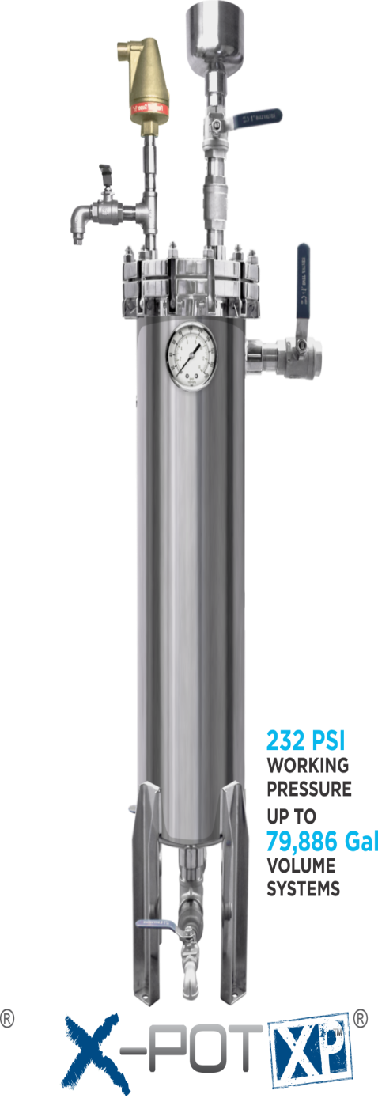
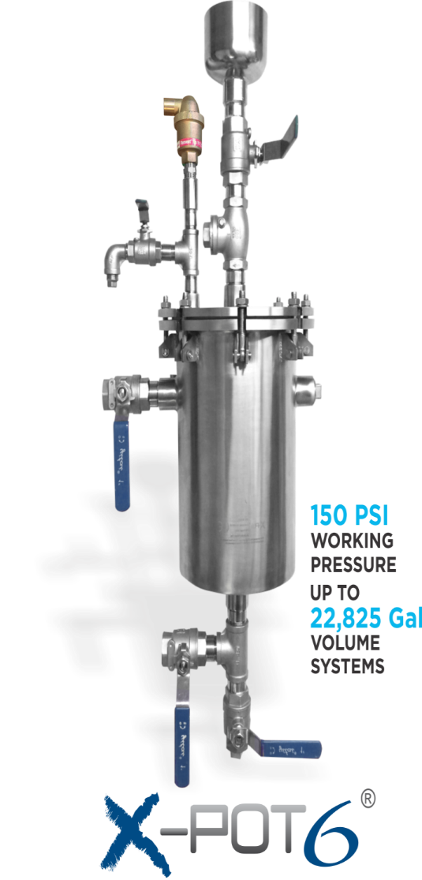
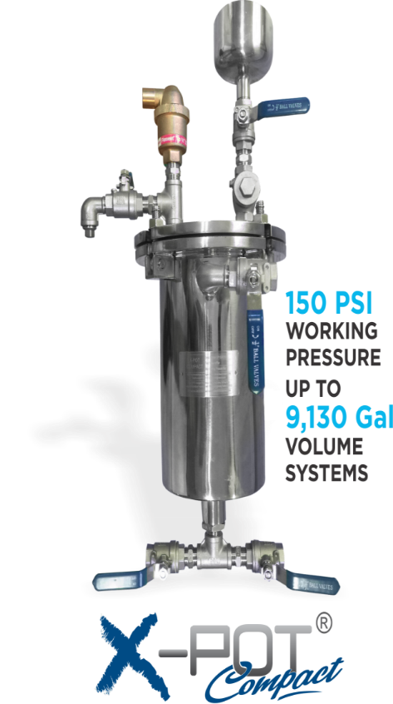
X-POT Model Types
4 Magnets & Cartridge Filter 6 Magnets & Cartridge Filter 13 Magnets & Bag Filter

Slide 11
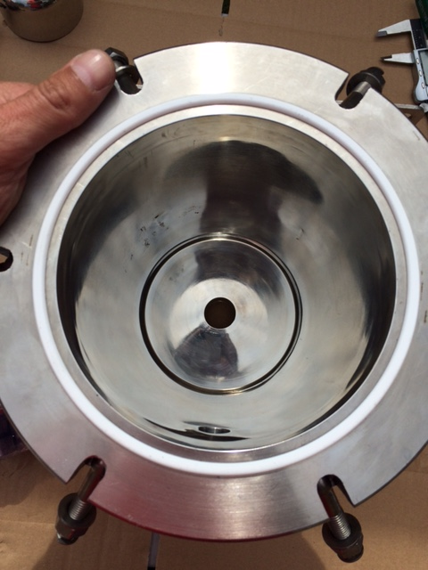
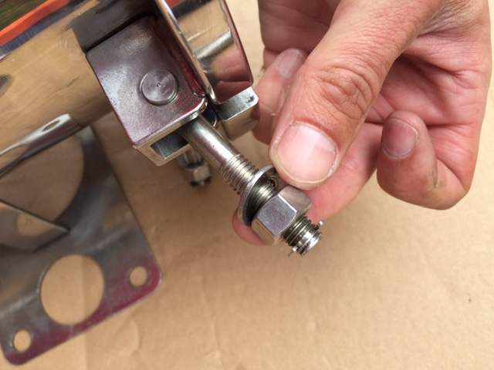
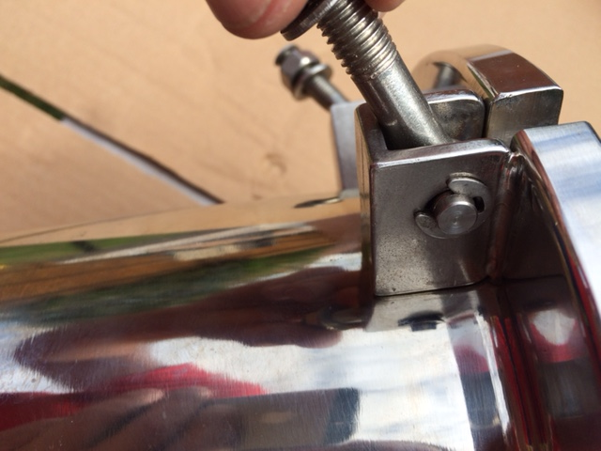
Above: PTFE Gasket & 4 off Fasteners ( US Version has 6)
Above: Each Fastener is made from M10 S/S Studded Rod with a 16/17mm or 21/32 Nut and washer, plus a circlip to prevent losing the Nut.
Left: Each Retainer is secured to the X-POT by a welded housing block and a circlip.

Slide 12
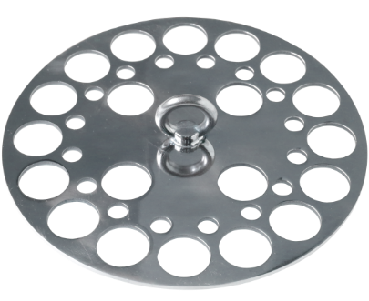
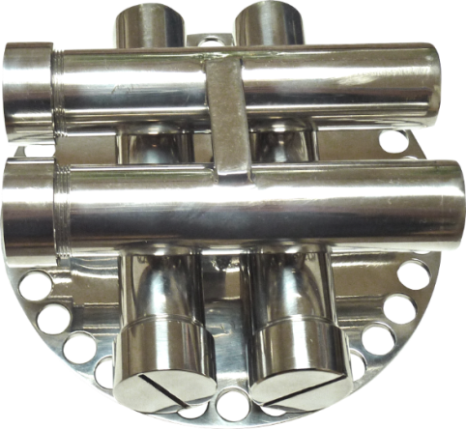
Internal Components
Magnets /Magnet Grate & Baffle Plate
1 off 316 S/S Highly Polished Magnet Grate with Screwed Cap ends (Cap Ends removable using a Flat Head screwdriver)
Magnet Grate contains 4 off D20 x114 mm S/S encased rare earth magnets (with screw at end to aid removal).
Each magnetic bar is consisted of stainless steel tube and a strong surface flux of 8000 Gauss NdFeB Magnets.
1 off 316 Highly Polished Baffle Plate- Acts to separate the Magnetic and non-magnetic chambers with each X-POT, It also comes with 4 off Pins that locate into the Cartridge Filter. The pins also elevate the Baffle Plate from the Base of the X-POT should “Magnetic Filtration Only” be required (For Heavily fouled systems containing Iron).
Baffle Plate
Baffle Plate with Magnet Grate Sited above

Slide 13
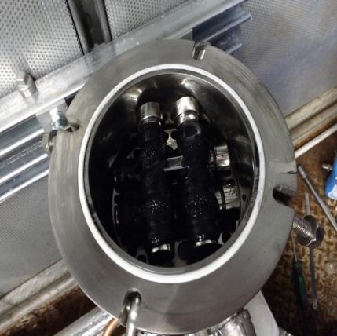
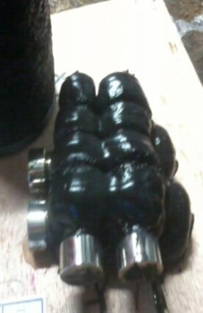
Dirty Magnet Grate
Lid removed to access Magnet Grate (Sited above the Baffle Plate) with Cartridge Filter below
Heavily Fouled X-POT Compact magnet Grate

Slide 14
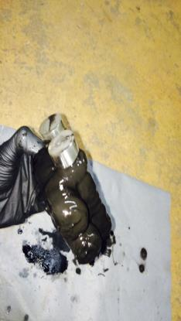
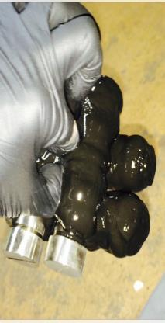
Huge Magnetic Power!
The Primary Chamber is equipped to deal with even the heaviest fouled systems, making the secondary chamber filter last even longer than its competitors!
Sludge removed from Radiators and Air Handling Unit Batteries

Slide 15
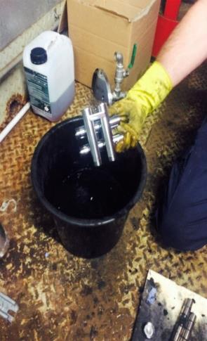
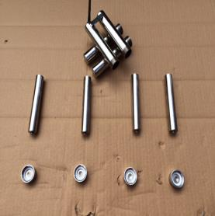
Magnet Grate Cleaning
Left: By removing the magnets from the magnet grate allows a “simple rinse” to remove the magnetite. Once removed the magnets should be kept clear of dirty surfaces containing iron deposits.

Slide 16
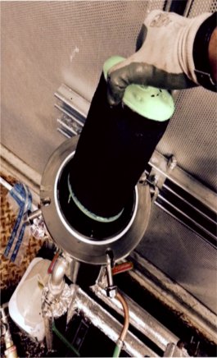
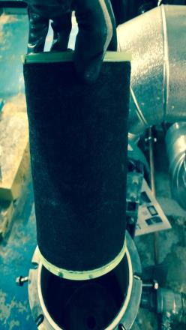
Dirty Filter Removal
PTFE Seal

Slide 17
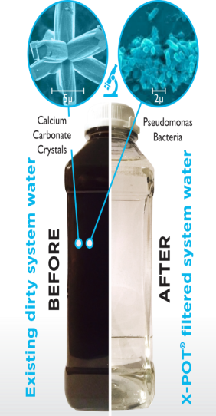

Slide 18
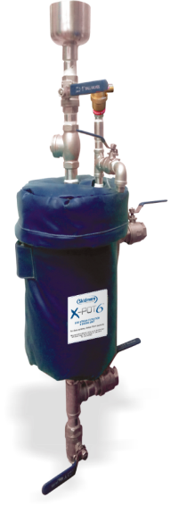
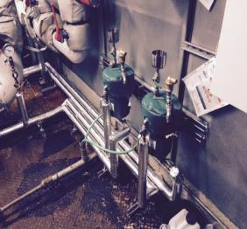
X-POTS are supplied with a Fabric encased fibreglass Insulation Jacket and Lid. These are detachable and secured using a Velco Fastener

Slide 19
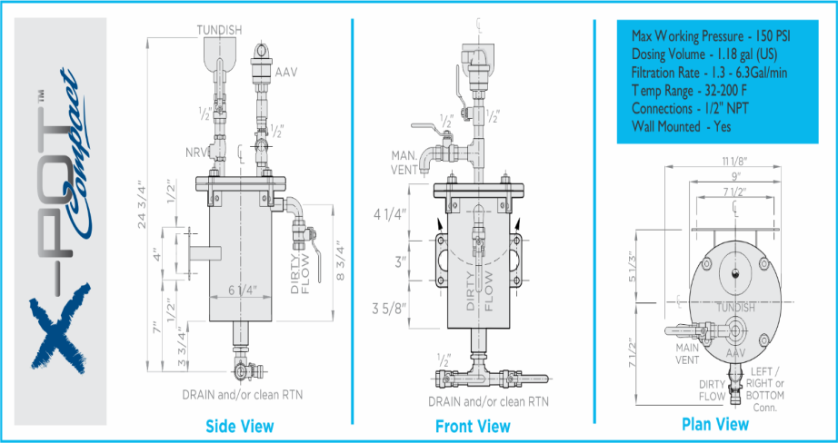

Slide 20
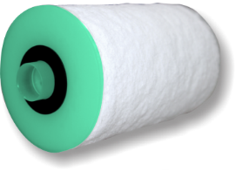
FILTER TYPES
X-POT Compact & X-POT 6 Use the same Cartridge Filter
X-POT XP Uses a Bag Filter
Recommend Filter changes quarterly

Slide 22
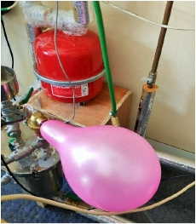
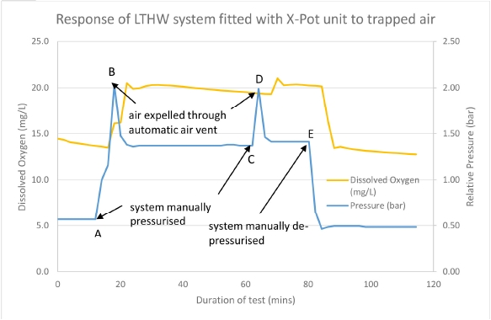
THE X-POT ALSO HELPS TO REDUCE AIR AND OXYGEN-FURTHER REDUCING CORROSION RATES

Slide 23
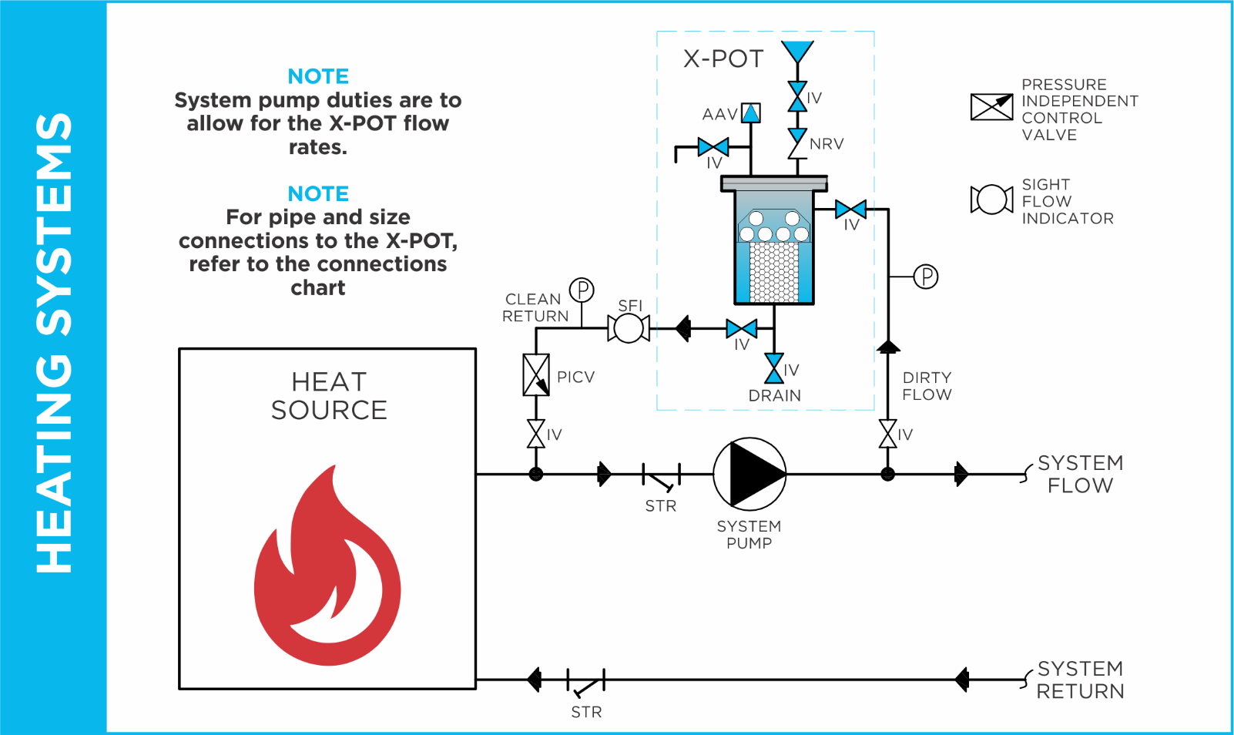
Generic Installation for X-POTs (HTG)
*System Volume to be directed through X-POT over a 24 hour circulation period*

Slide 24
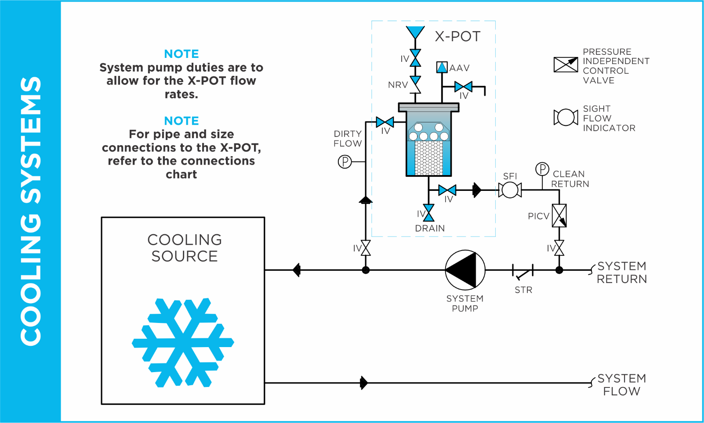
Generic Installation for X-POTs (CHW)
*System Volume to be directed through the X-POT over 24 hour Circulation period*

Slide 25
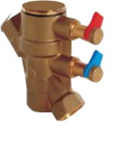
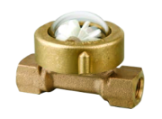
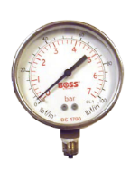
Ancillary Items required
1off PICV (actuator Head not required) to regulate flow rate through the
X-POT when fitted to Variable speed pumps. For Fixed speed a standard DRV can be installed.
Sight Flow Indicator-Simple way to identify if the Filter is becoming or is in fact blocked and required swapping out.
2off Pressure Gauges- Identify pressure is safe, should maintenance become required on the flow and return lines. Also back up aid, should the sight glass becomes dirty/stained.

Slide 26
X-POT Case Study in USA By Skidmore
Site:
Naper Boulevard Library
2035 S. Naper Blvd.
Naperville, IL 60565
Install date:
May 13, 2016
System:
Closed Loop Hydronic Heating & Cooling
Rep:
Illinois Mechanical sales- Hugh J. Mallaney
Installer:
Hayes Mechanical- Contact: Jim Cherf
Skidmore associates:
Josh Nevil & Curt Lake

Slide 27
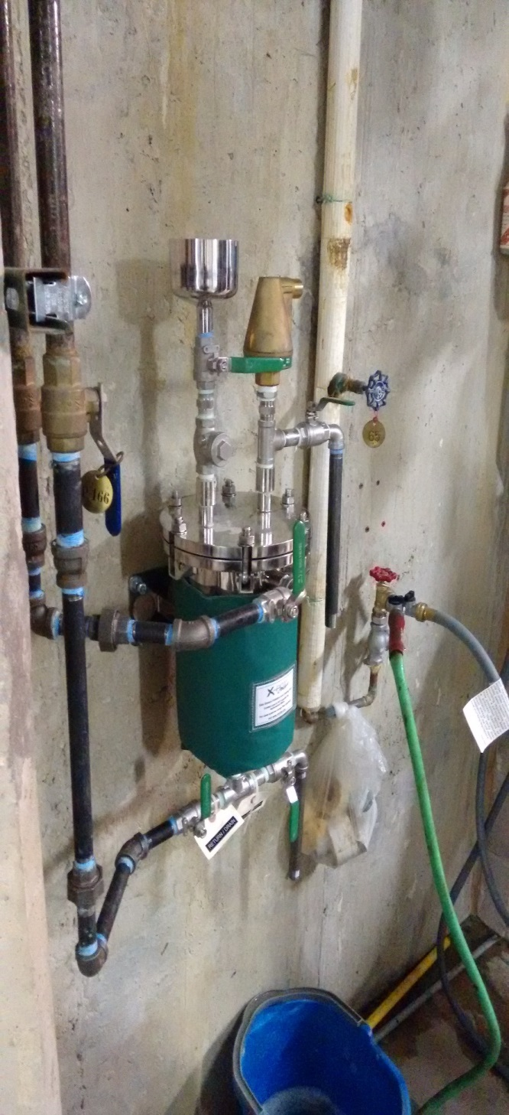
AAV
Manual Vent (To Bucket)
Funnel
Removable Lid/Top Flange
Dirty Flow in (+ Pressure)
Clean Return (Pressure)
Drain
Above: X-POT Compact unit Installed

Slide 28
Jobsite system type: Closed loop hydronic heating and cooling system. X-POT Installation: The X-POT is a retrofit from the original side stream chemical tank feeder, with the return piped into the suction side of the pump and the inlet piped into the discharge side of the pump. System problems and procedures: No problems currently exist in the current system except the normal buildup of rust and calcium deposits in the system. The current installer provides routine maintenance on the system mechanics and provides standard water system flush and clean out. The customer has a water treatment contract with a different provider. Water & System Quality: Visually, the water is 100% clear and free of all suspended solids. X-POT Magnet filter cleaner: Magnets are currently picking up magnetic solids in the fluid and is working as designed. Magnet assembly has been cleaned and reinstalled into the unit X-POT cartridge filter: The 100 micron filter has a collected a large amount of non-magnetic debris. A new 50 micron filter has been installed in the system. Installers Review of product and comments: Project manager Jim Cherf is pleased with the water clarity and the amount of debris the magnet and filter is removing from the system.

Slide 29
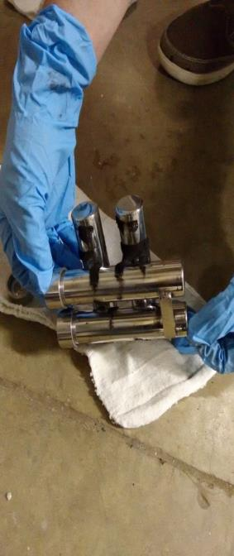
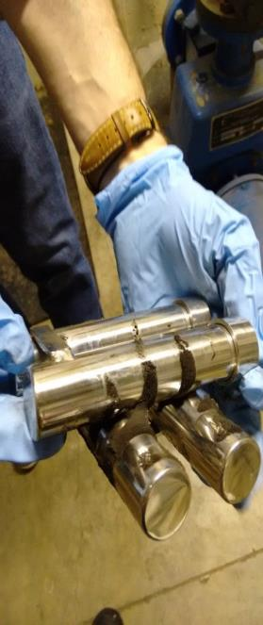

Slide 30
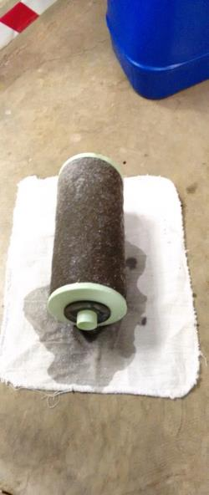
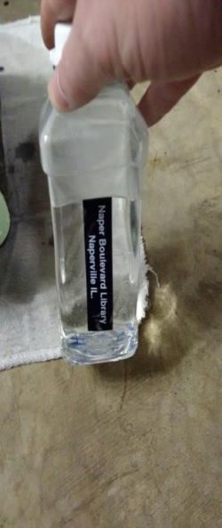

Slide 31
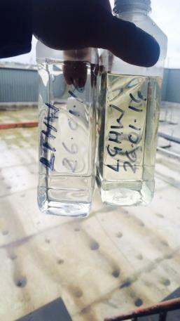
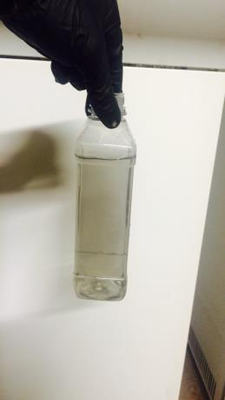
Other examples of systems cleaned-up with an X-POT
50 year old system (No Inhibitor)
Same system 1 hour after adding X-PO10 Inhibitor

Slide 32
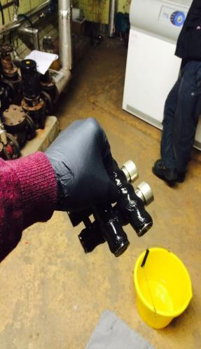
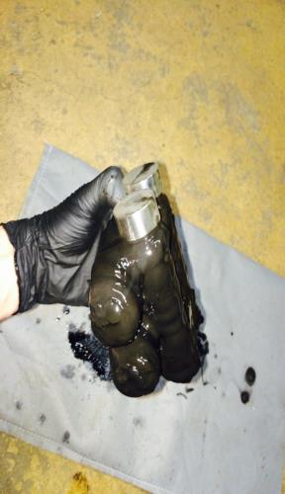
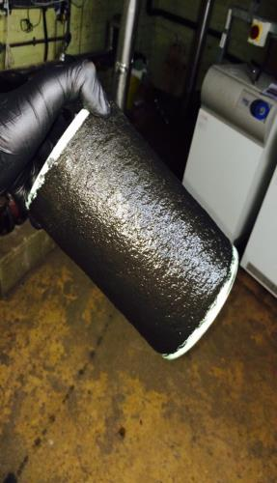
Other examples of systems cleaned-up with an X-POT
X-POT Compact Magnets post 1 hour from dosing X-PO10 Inhibitor
Same system 12 days later
20 micron Filter (Not blocked)

Slide 33
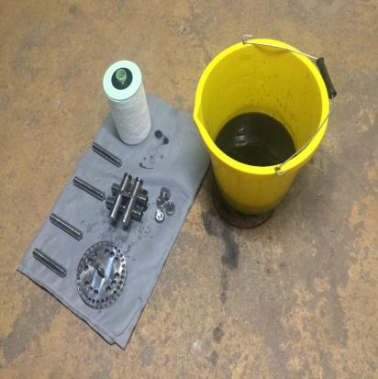
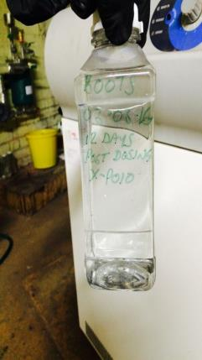
Other examples of systems cleaned-up with an X-POT
Magnet Grate post cleaning & new filter ready
Final system water after 12 days

Slide 34
THANK YOU FOR YOUR TIME AND EFFORT

